Slide 1
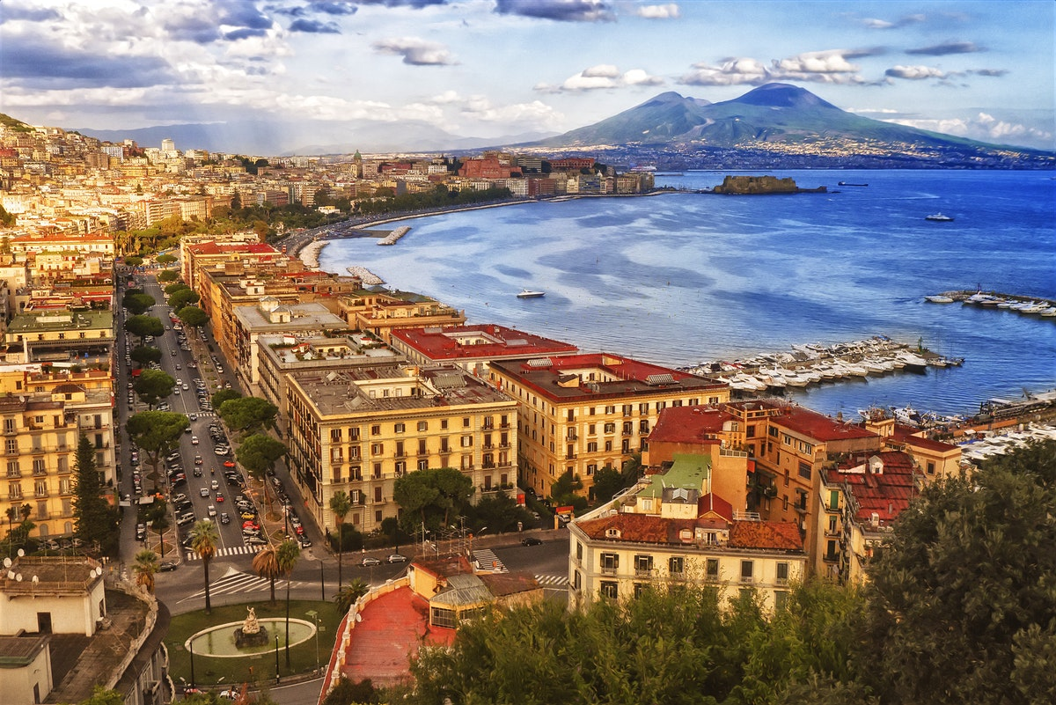
Best neighbourhoods in Naples to open an office

Slide 2
Where to open an office in Naples?
There's an Italian IT growing company that is planning to open a new office.
The first office is in Naples and the second one should be there too.
I will analyse which one is the best location for the new office, my goal is to satisfy both entrepreneur and employers needs to create the best working environment.
The office should be in a zone that can be easily reached, in a zone with restaurant and coffee shops so that the employers can enjoy their breaks.
This analysis can be actually reused from anyone intends to open a new office in Naples and care about the happiness of their employers.

Slide 3
The data
I will do a GET request of the Wikipedia website (https://it.wikipedia.org/wiki/Quartieri_di_Napoli)
I will use the list in this website: https://news.unicreditsubitocasa.it/vendere-e-comprare/napoli-quartieri-prezzi-immobili-trasporti/ to retrieve the best neighbourhoods and to create a map of them, to have a better understanding of the area we are going to analyse.
I will use a csv file about the coordinates of the stations in each neighbourhood and finally I will use the Foursquare API to figure out which one is the perfect place for a new office, looking for a place near a train station and with a good choice of restaurants and coffee shops that results good for workers.

Slide 4
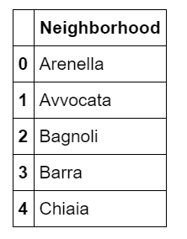
Research method
I firstly have retrieved the data about neighbourhoods from Wikipedia website. Then I worked on it to create a dataframe.

Slide 5
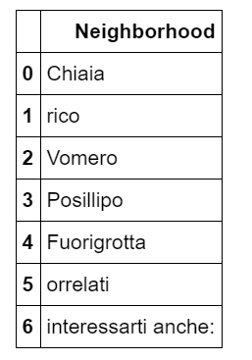
Research method
For a in-depth analysis I've retrieved the data from another website in which are described the best neighbourhoods where to live in Naples and I've compared my dataframe and the one built with the second website data to get the existing best neighbourhoods.

Slide 6
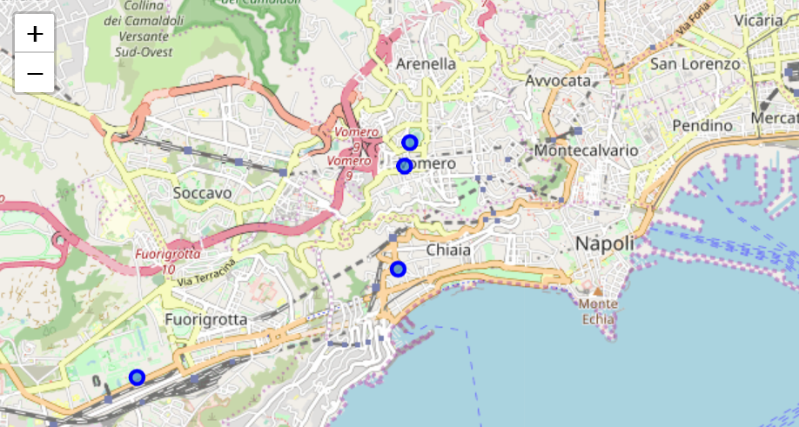
Research method
I've mapped the train stations for each neighbourhoods and I've figured out that the most easily reachable is the Vomero neighbourhood, because there are two station in a radius of 250m.

Slide 7
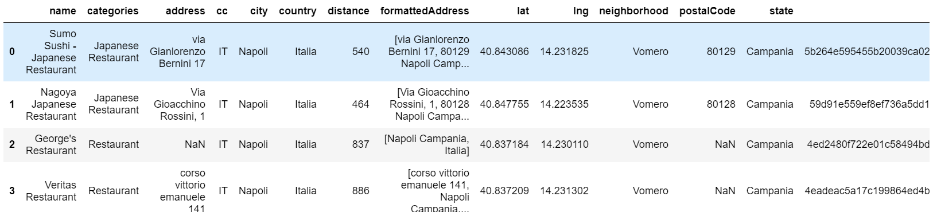
Research method
With Foursquare API I've retrieved the data about nearby restaurants and set up a dataframe

Slide 8
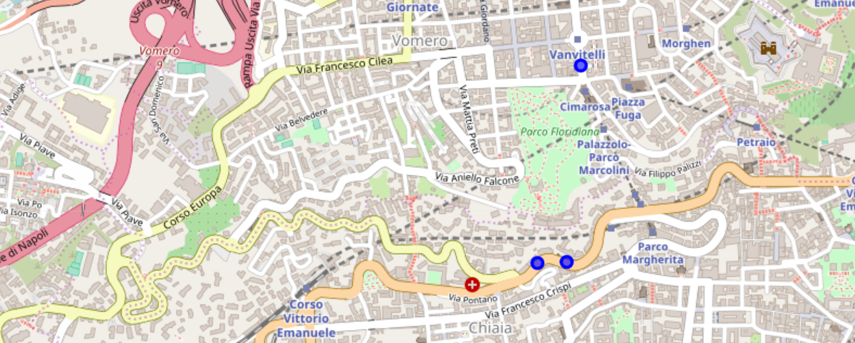
Research method
I mapped the results: as you can see with the basic Foursquare developer account there are few venues returned by the API.
According to these results I think that the best place to open an office in Naples is between Vomero and Chiaia neighbourhoods. In fact there are more restaurants and there is a park too, where the employers can enjoy their breaks.

